Slide 1
7th Grade Literary Terms
Mrs. Moore-English 7

Slide 2
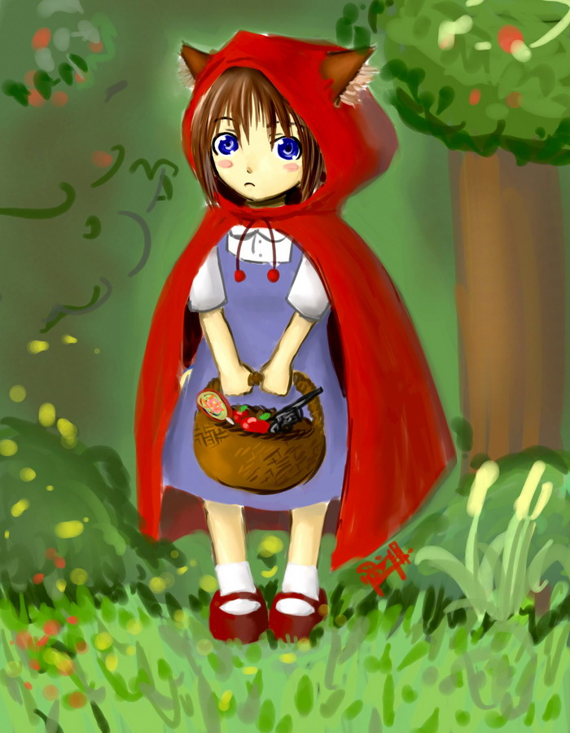
Protagonist
The central character in a story; involved in the main conflict of the story.

Slide 3
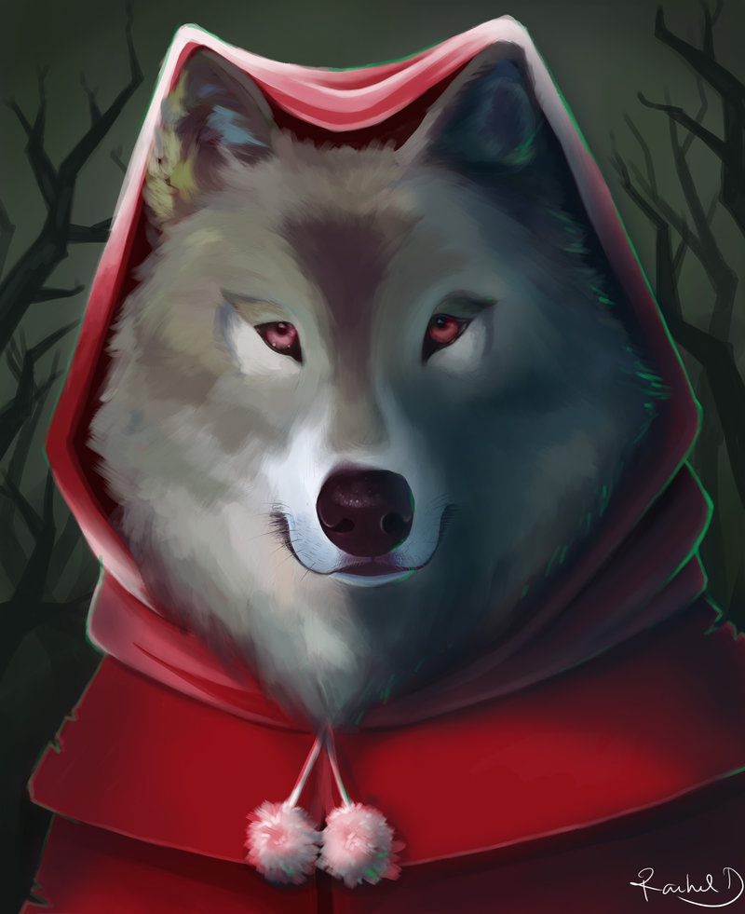
The character, object, idea or force that opposes the protagonist.
Antagonist

Slide 4
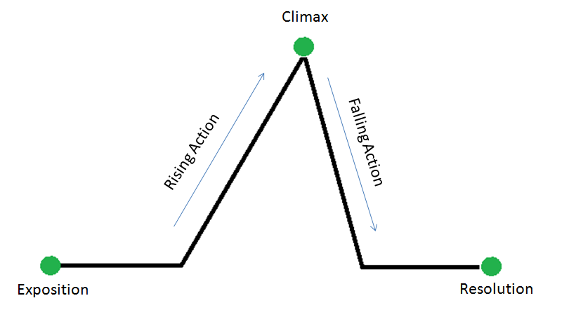
Plot The sequence of events in a story.
Think of the plot triangle.

Slide 5
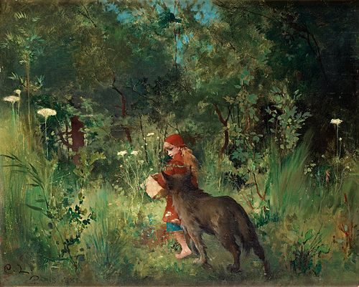
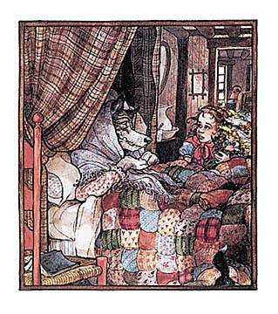
Setting
The time and place of the action of the story.

Slide 6
Complications
Problems that arise as the characters struggle to reach their goals.

Slide 7
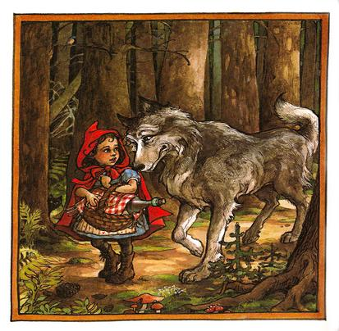
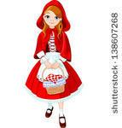
Apply the terms to Little Red Riding Hood
Little Red Riding Hood is the protagonist. The wolf is the antagonist.

Slide 8
PLOT
Little Red Riding Hood meets the wolf.
The wolf goes and eats Granny.
He dresses as Granny.
Little Red Riding Hood screams when the wolf tries to eat her.
The woodman comes and kills the wolf.

Slide 9
Setting:
In the woods and at Granny’s house a long time ago.

Slide 10
Complications (Part of the rising action)
The Big Bad Wolf eats Granny

Slide 11
Plot (broken down)

Slide 12
Exposition
-The beginning of the story
-Characters, setting and basic situations are revealed

Slide 13
Inciting Incident
The event that sets the story in motion.

Slide 14
Rising Action
-Main part of the story
-Events leading to the climax.

Slide 15
Climax
The turning point or highest point of excitement in the story.

Slide 16
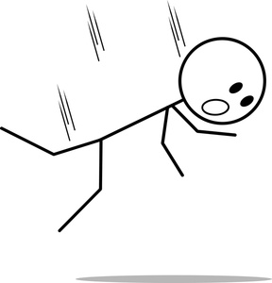
Falling Action
The events that follow the climax.

Slide 17
Resolution
The end of the story
Conflicts are resolved

