Slide 1
The Cay
BY: Theodore Taylor

Slide 2
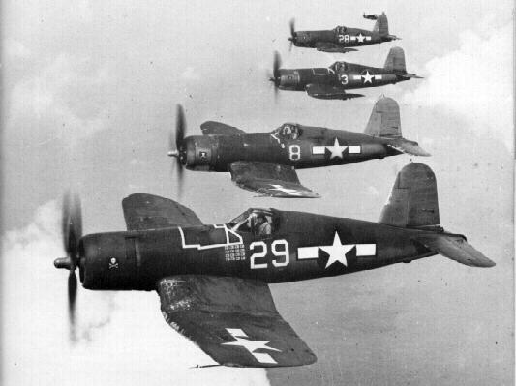
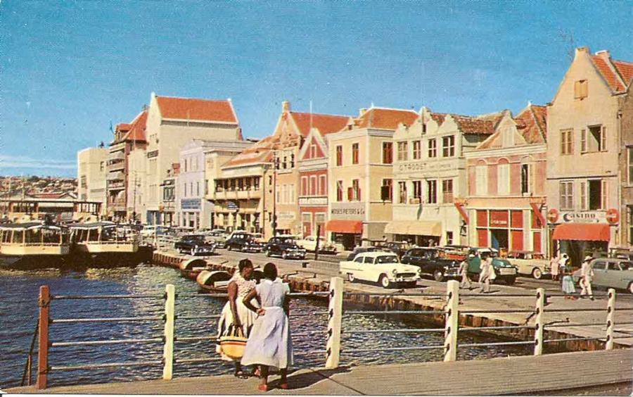
The Cay: Introduction
The year is 1942 – World War II is raging.
Eleven-year-old Philip Enright lives on the island of Curaçao, in the Dutch West Indies.

Slide 3
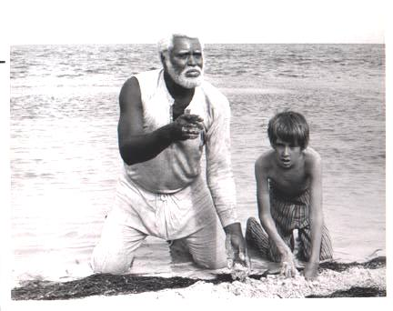
The Cay: Introduction
There is also Timothy, an old West Indian black man who knows a lot about survival, but is very different from Phillip.

Slide 4
The Cay: Introduction
Prejudice still exists in this time.
When one is prejudice, they make a firm judgement of someone before they get to know the person

Slide 5
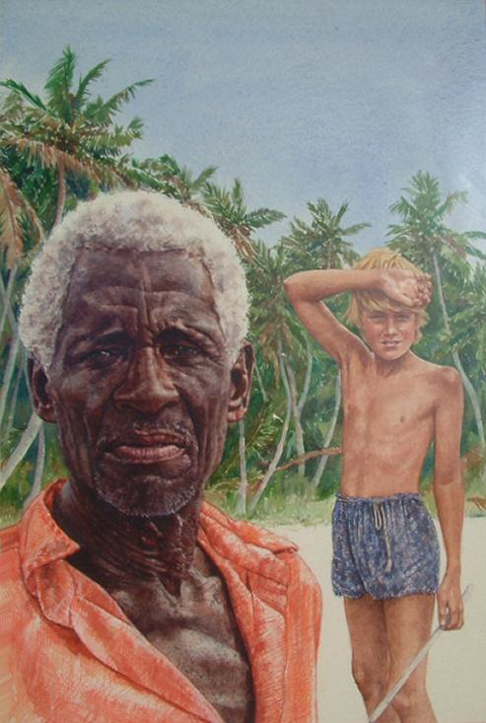
The Cay: Introduction
Phillip is prejudiced against black people…
But he is now dependent on
Timothy for survival.
He faces an inner conflict:
How should he treat Timothy?
Can he learn to trust him? Even like him?

Slide 6
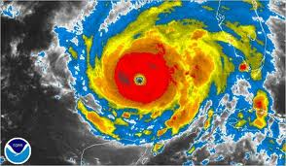
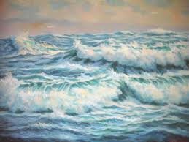
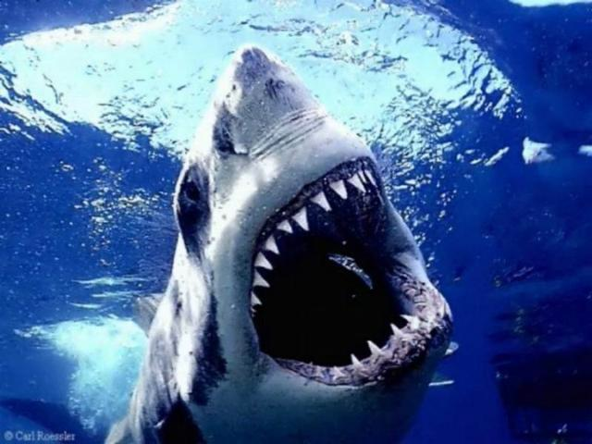
The Cay: Introduction
Both characters experience external conflict.
Struggling for survival, they have conflict with nature
and their circumstances.

Slide 7
The Cay: Introduction
Timothy and Phillip are trapped on a tiny island.
It is remote and uninhabited.
There is little food or water.
Their chances for rescue are SLIM.

Slide 8
The Cay: Introduction
Can Timothy and Phillip survive?
How will their relationship develop as they live together on the island?
What changes might take place in Phillip?

Slide 9
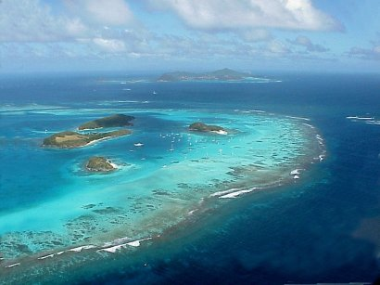
The Cay: Background
Cays – also called keys – are small low islands

Slide 10
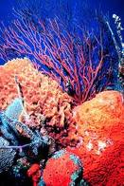
The Cay: Background
Cays develop on the edge of coral reefs.
Sand, coral, and debris fills up
Birds drop seeds
Plants grow from seeds
Plants make the cay more stable

Slide 11
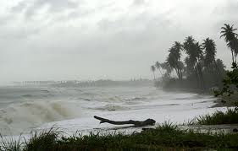
The Cay: Background
Most cays only rise 5 to 10 feet above the level of
high tide.
Even a fairly large cay can be destroyed by a hurricane
or other severe storm.

Slide 12
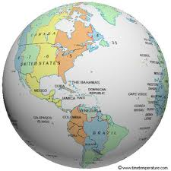
The Cay: Background
Phillip and Timothy end up on a cay in the
West Indies –
- A chain of islands located between the Caribbean
and the Atlantic Ocean.

Slide 13
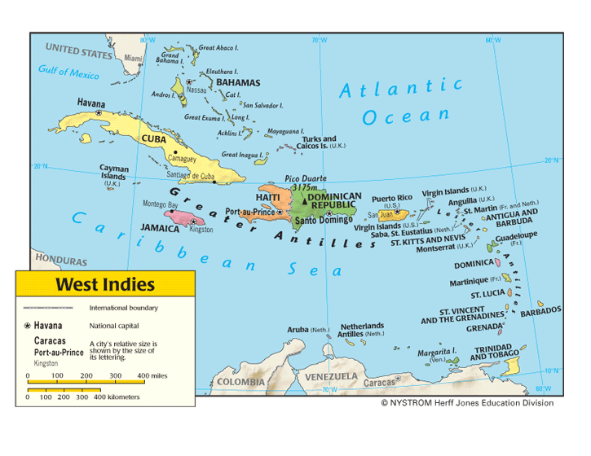
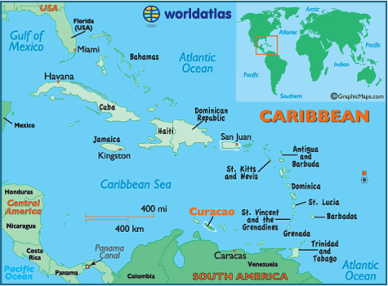
The Cay: Background
The West Indies includes Cuba, Jamaica, Haiti, Puerto
Rico, Curaçao, the Bahamas, Grenada, and the Virgin
Islands, plus many smaller islands.

Slide 14
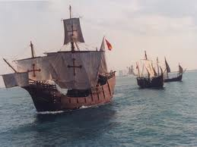
The Cay: Background
Originally, American Indians inhabited
the West Indies….
After Christopher Columbus discovered them in 1492, various European countries started to take them over.

Slide 15
The Cay: Background
Today, most of the islands and island groups in the
West Indies are independent nations.
Jamaica
Grenada
The Bahamas

Slide 16
The Cay: Background
However, some are still controlled by other countries, such as the United Kingdom, the Netherlands, and the United States.

Slide 17
The Cay: Background
Dialect: A form of language used in a certain
geographic region; it is distinguished from the
standard form of language by pronunciation, grammar, and/or vocabulary
“Do not eben look at d’wattah. D’glare is
bad too.” - Timothy

Slide 18
The Cay: Background
U-boats, the submarines used by Germany in World
War II, were among the most feared weapons of the war.

Slide 19
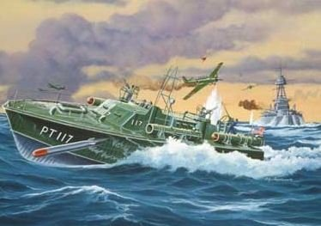
The Cay: Background
German U-boats:
Weighed over 500 to 700 tons
Could travel very fast underwater
The torpedoes on these submarines:
Could crack the metal in a ships hull
Could follow the noise of a propeller in
order to hit the target

Slide 20
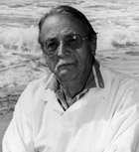
Theodore Taylor
born June 23, 1921 in North Carolina
during the Depression his father left the family to find a job
Taylor sold candy, scrap metal, and delivered papers to help the family
began writing career for a newspaper at age 13 – sports for local high schools

Slide 21
Theodore Taylor
also became member of the naval reserve
on tour of duty during Korean War, spent time on
Caribbean island – inspired setting for The Cay
His life experiences and travels contributed to
his writing
“I find it hard to write about what I have not seen or in some way experienced.”

Slide 22
The Cay: Dedication
Theodore Taylor’s Book Dedication:
To Dr. King’s dream
which can only come true
if the very young know and understand

Slide 23
The Cay: Dedication
An excerpt from Dr. Martin Luther King Jr.’s “I have a dream…” Speech
“I have a dream that one day this nation will rise up and live out the true meaning of its creed, ‘We hold these truths self evident, that all men are created equal.’…I have a dream that my four little children will one day live in a nation where they will not be judged by the color of their skin, but by the content of their character.”

