Slide 1
Colonial Economy
Aim: How did climate and natural resources affect colonial economy?

Slide 2
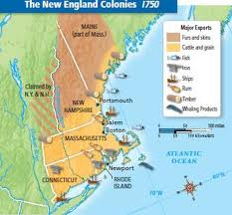
New England Industries
People in New England found an abundance of natural resources in the cold water of the North Atlantic Ocean.
The Sea was full of fish which made the fishing industry very popular in New England.
Another industry that used the natural resources of New England was the lumber industry.
Wood was used to build:
Ships
Houses
Furniture

Slide 3
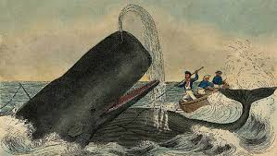
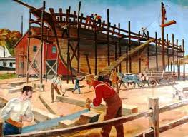
Many people in New England lived and worked in small towns and cities near ports. The shipbuilding industry was very successful in New England and helped make fishing and whaling successful.

Slide 4
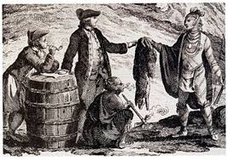
Iron and Furs in the Middle Colonies
The colonists in the Middle Colonies had a very good relationship with the Native Americans. This helped the colonists develop a fur trade with Europe.

Slide 5
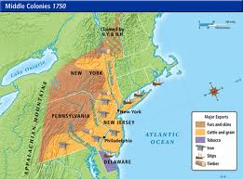
The Middle colonies also had several iron furnaces. Furnaces were used to melt iron ore into bars that could be shaped into pots and tools. Both fur and iron helped to vary the economy in the Middle colonies.

Slide 6
Industries in the Southern Colonies
A very important product made in the Southern Colonies was tar. Tar was sold to British and colonial shipbuilders and sailors. Tar was made from a sticky substance found in pine trees.

Slide 7
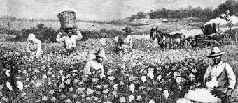
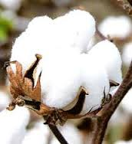
Another industry that developed in the Southern Colonies was cotton. Cotton, which grows on plants, can be made into cloth. The cotton from the South was shipped to England

Slide 8
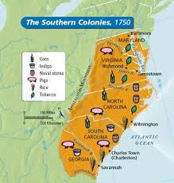

Slide 9
The Growth of Cities and Towns
The many colonial industries led to growth of cities and towns.
People who live in town also had special skills such as
shoe makers
barrel makers
potters
printers
blacksmith
These craftsmen made the everyday items people needed. There were no factories, so many of these items were made in the homes.

Slide 10
Controlling Colonial Trade
In the beginning, the English colonies trade with many countries. These countries include:
Netherlands
France
Spain
England was not happy about this. It established the colonies in order to make England rich not its rivals.

Slide 11
The Mercantile System
England had an economy based on the mercantile system. This system allowed a nation to become wealthy through trade. England wanted export, or sell, more products than it imported, or bought.
England used the raw material that the colonies produced in order to make finished products like:
Furniture
Tools
Clothing
England then sold these items back to the colonists and required the colonists to buy the finished products. The colonists were not allowed to use the raw materials to make their own finished products.

Slide 12
Navigation Acts
The Navigation Acts were a series of laws created by England in order to control colonial trade. The Navigation Acts placed the following limits on colonial trade:
All good shipped to and from the colonies had to be carried on English or colonial ships
Important colonial goods that England did not produce such as tobacco and cotton could be shipped only to England
Ships from other European countries had to stop in England first so that England could collect tax on their cargo.

Slide 13
The Navigation Acts caused a rise in the price of goods in the colonies and limited trade.
Some colonists agreed with the laws. However those that did not began smuggling, or trading goods illegally with other countries. The Navigation Acts produced the first tensions between England and the colonies.

