Slide 1
Early People of the Americas
How did the first Americans come to North America?
Most Scientists believe that the first people to live in the Americas walked there from Asia.

Slide 2
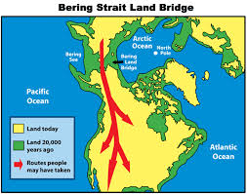
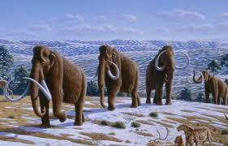
Land Bridge from Asia
More than 30,000 years ago huge glacier covered most northern regions of the globe.
This caused a land bridge to form in the Bering Sea, called the Bering Land Bridge or Beringia.
It connected the continents of Asia and North America. This bridge allowed hunters to cross from Asia to North America.
These hunters were called nomads. Nomads are people who move constantly in search of food. The Nomads hunted herds of animals.

Slide 3
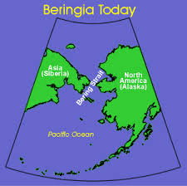
Migration
For over 1,000 years the nomads migrated or moved throughout the continent they had discovered.
The climate began warming and the Ice Age was ending. As a result the ice that created the land bridge began to melt
Other changes included the formation of lakes and the return of plants and animals to the forest.
Many large animals died because humans began hunting.

Slide 4
Video time!
http://www.youtube.com/watch?v=cJaMyd8cNYQ&index=1&list=PL-3zZVV76nB8K217QGFZFFAWTcRrxibfk

