Slide 1
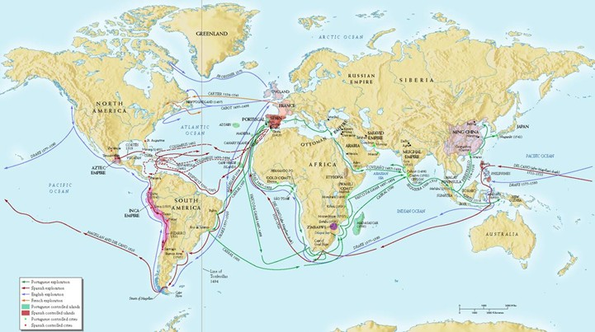
Major Voyages to the Americas

Slide 2
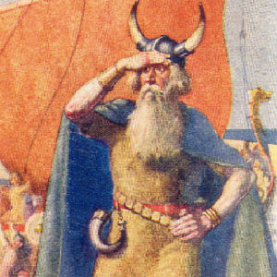
What group first explored the west?
In 1001, Viking sailors led by Leif Erikson reached the northern tip of North America.
The voyages of the Vikings were not known to the Europeans.
http://www.history.com/topics/exploration/leif-eriksson

Slide 3
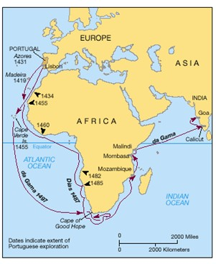
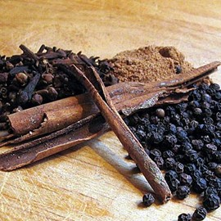
European Exploration
In the early 1400’s Portugal dominated sea travel.
Portuguese explorers like Prince Henry the Navigator, Bartholomeu Dias, and Vasco DeGama were dominating trade routes to Asia
They were not interested in setting up colonization

Slide 4
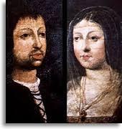
We want in too!!!
Spain, like Portugal, wanted to develop trade routes to Asia. Queen Isabella and King Ferdinand of Spain hired Christopher Columbus to sail for their country.

Slide 5
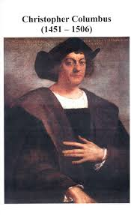
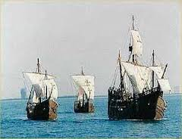
Columbus sails for Spain
In August 1492, Columbus began his expedition, or journey, with three ships, the Nina, the Pinta and the Santa Maria
On October 12, 1492 Columbus and his crew spotted land in the Caribbean Sea, named it Hispaniola and claimed it for Spain. This land is the present day Haiti and the Dominican Republic .

Slide 6
Columbus thought he has landed in Asia, where the Europeans called the islands “the Indies”. When Columbus met the people there he called them Indians; however, they were Native Americans.
These Native Americans called themselves Taino. Columbus brought the Taino people back to Spain and sold them as slaves.
Columbus made three more voyages across the Atlantic to the Caribbean Sea in search of gold.

Slide 7
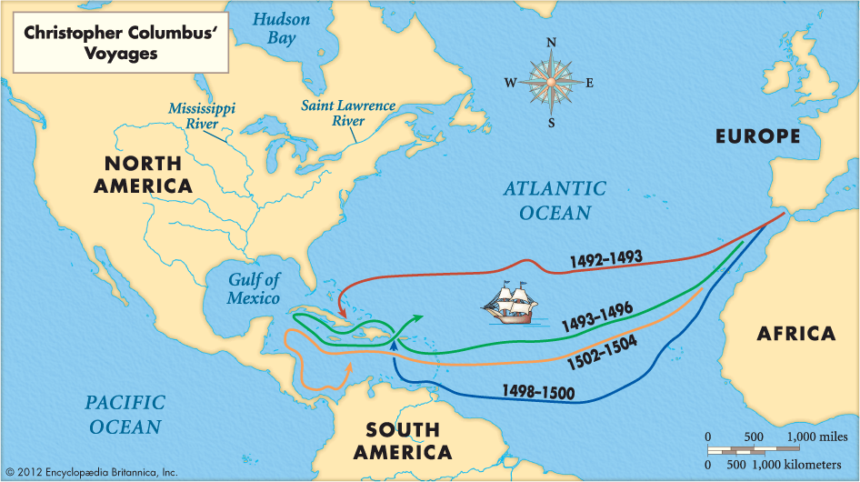
Columbus thought he had landed in Asia, where the Europeans called the islands “the Indies”. When Columbus met the people there he called them Indians; however, they were Native Americans
These Native Americans called themselves Taino. Columbus brought the Táino people back to Spain and sold them as slaves.
Columbus made three more voyages across the Atlantic to the Caribbean Sea in search of gold.

