Slide 1
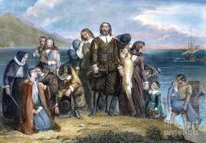
Pilgrims
Settlement at Plymouth

Slide 2
Settlement at Plymouth
Separatists: wanted to set up their own church separate from the church of England. Later, they became know as Pilgrims.
Pilgrims were looking for a place where they could live and worship freely. In England they were being persecuted for their beliefs.

Slide 3
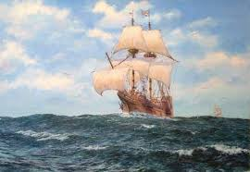
Voyage across the sea…
The Pilgrims decided to make a voyage to America. In 1620 they ended up landing far north of Virginia near Cape Cod.

Slide 4
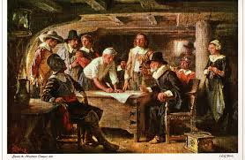
Mayflower Compact: forty one pilgrim men signed it agreeing to consult each other about laws for the colony and promised to work together to help the colony succeed. Later they chose members to a council.

Slide 5
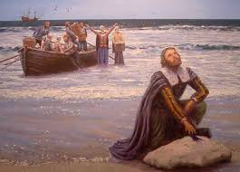
The Pilgrims called their settlement Plymouth because they had sailed from Plymouth, England.

Slide 6
http://www.scholastic.com/scholastic_thanksgiving/webcast.htm

Slide 7
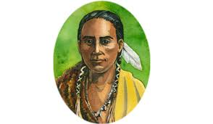
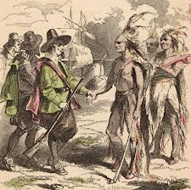
Hardships the Pilgrims Faced
No friends
No shelter
Disease
Starvation
Squanto, a native American, helped the Pilgrims. He taught the Pilgrims to grow crops and to trap beavers.

Slide 8
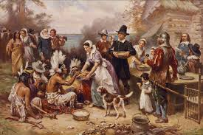
The Pilgrims celebrated in the fall of 1621 after harvesting their first crops. This day is what many people today think of as Thanksgiving.

