Slide 1
Slavery in the Colonies

Slide 2
Slavery Takes Root
The growth of the plantation system in the Southern colonies resulted in an increased number of slaves who were used as laborers. As the number of colonists grew so did the number of slaves.

Slide 3
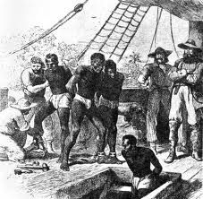
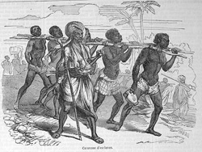
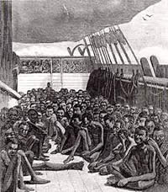
The Middle Passage
Most slaves were brought to the colonies from West Africa in trading ships and were treated like cargo.
Several different trade routes were used by the colonists. However, the trade route used to transport slaves took a different course. This course went from the colonies, to West Africa, then to the West Indies and finally back to the colonies. This route was called the triangular trade route because the three separate parts which formed a triangle.

Slide 4
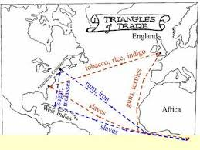

Slide 5
Trade Routes
First part of the trip:
Ships went from New England to West Africa
Run and iron goods were traded for slaves
Second part of the trip:
Called the Middle Passage
Ships sailed from Africa to the West Indies
Some slaves were traded for molasses and sugar
Many slaves died on the Middle Passage because of bad conditions on board the ships

Slide 6
Third part of the trip:
Ships sailed back to New England
Carrying sugar/molasses and remaining slaves

