Slide 1


Spain Builds an Empire
Aim: How was Spain able to set up a colonial empire?
7th Grade American History

Slide 2

The Conquistadors
Conquistador: Spanish explorers who claimed lands in the Americas for Spain.
Conquistadors came to the America’s to:
  “Serve god and the king and also to get rich.” Bernal Díaz del Castillo
  The Three G’s: 1) Gold, 2) Glory, and 3) God
The rulers of Spain allowed conquistadors to establish settlements in the Americas. In return conquistadors paid 1/5th of gold or treasure they found or captured.

Slide 3

Conquest of the Aztecs
STOP & JOT!! Where did the Aztec civilization live?
Hernando Cortés a conquistador, lusted for gold and glory.
In 1519, he set sail with 600 men and 16 horses bound for the rumored wealthy native empire in Mexico.
The Aztec ruler Montezuma welcomed Cortés to his empire but soon he regretted his decision…
Cortés betrayed Montezuma's kindness and made him a prisoner in his own empire.
Cortés killed Montezuma and sacked the Aztecs. The Aztec Empire had fallen.

Slide 4
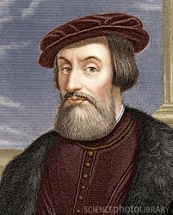
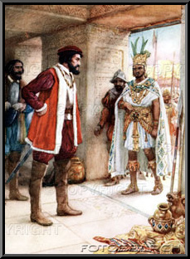
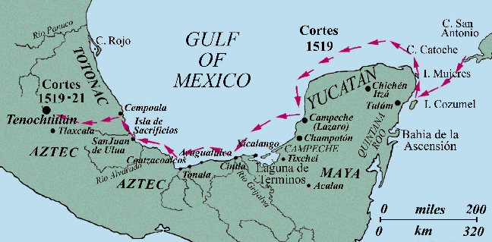
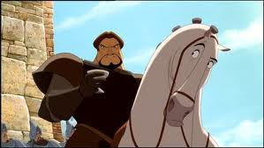

Slide 5
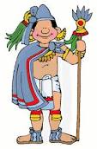
Conquest of the Incas
STOP & JOT!! Where did the Incan civilization live?
Conquistador Francisco Pizarro sailed down the Pacific coast of South America with fewer than 200 Spanish soldiers.
In 1532, Pizarro captured the Incan emperor Atahualpa and later executed him.
Without the leadership of Atahualpa the Incan resistance collapsed.
By 1535, Pizarro controlled a majority of the Incan empire.

Slide 6
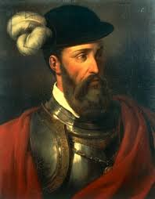
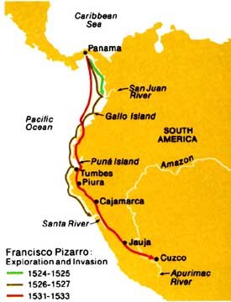
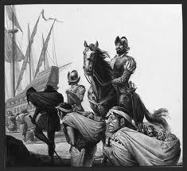

Slide 7
DO NOW! Let’s think!
During the century after Columbus’ voyage, the Spanish government sent a number of military expeditions to America to explore the New World and conquer the Natives. One of these was led by the conquistador Francisco Coronado, who in the 1540s led an army through the region that centuries later became known as the southwestern United States. What follows is a short excerpt from the orders he and other conquistadors were given.
“You must explain to the natives… that there is only one God in heaven, and the emperor on earth to rule and govern it, whose subjects they must all become and whom they must serve.”
With orders like this one, how do you suppose Coronado and his men treated the Natives?

Slide 8
Explorers of the Borderlands
Juan Ponce de Leon traveled through Florida in 1513 looking for the Fountain of Youth.
Panfilo Narvaez’s sailed to the Gulf of Mexico but was shipwrecked in a storm.
Hernando De Soto went from Florida to the Mississippi River in search of gold until his death.
Francisco Coronado, who was in search of the “seven cities of gold,” went from present day Arizona to New Mexico.

Slide 9

Settling New Spain
Spain had let the conquistadors govern the lands they conquered.
Although they were great conquerors, they were poor rulers.
The King appointed a viceroy to rule in the colonies in his name.
STOP & JOT!! What is a viceroy?
A code was established called the Law of the Indies. This code established three settlements: 1) Pueblos, 2) Presidios, and 3) Missions.
Notes:
VICEROY - the governor of a country or province who rules as the representative of a king or sovereign.

Slide 10
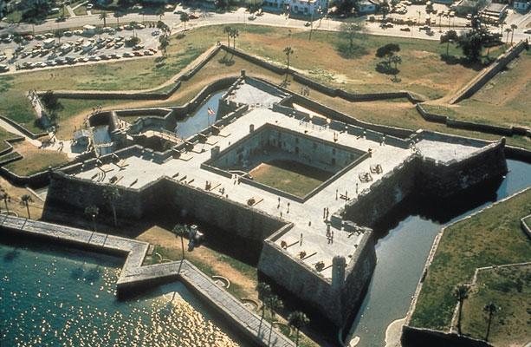
Settlements
Pueblos: or towns were centers of farming and trade and had a town square for business.
Presidios: were forts where soldiers were held to protect farmers and citizens. Example: St. Augustine
Missions: Religious settlements run by Catholic priests and friars.
Notes:
St. Augustine

Slide 11
Social Class
Peninsulares- White Europeans who were born in Spain.
Creoles- People born in the Americas to Spanish parents.
Mestizos- People of Spanish and Native American background.
Indians- Natives of the Americas.
Peninsulares
Creoles
Mestizos
Indians

Slide 12
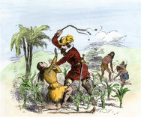
Harsh Life for Native Americans
Spain granted land grants called Encomiendas which allowed the Spanish to demand labor or taxes from the Natives.
Natives were forced to mine for gold and silver in dark, narrow mines with little or no food.
Bartolomè de Las Casas, a priest, sought out reform in New Spain and the Spanish homeland. Through hard work, leaders in Spain passed some laws but they were not enforced in the colonies.

