Slide 1
Spanish Conquest and Colonies

Slide 2
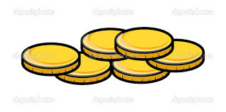
Christopher Columbus and other explorers from Spain came to the Americas for different reasons (the three G’s)
Gold Glory God

Slide 3
The following Spanish Explorers and conquerors, also known as conquistadors, traveled to the Americas in search of the 3 G’s gold, glory and god
Who? | What? | Where? | When? | Why?
Hernando Cortes | -Conquered Aztecs | Mexico | 1519 | to take their gold
Francisco Pizarro | -Conquered Incas | Peru | 1531 | To take their gold
Juan Ponce deLeon | -Claimed Florida for Spain -DID NOT find Fountain of Youth | Florida | 1513 | Looking for Fountain of Youth
Hernando DeSoto | Explored Mississippi River | North America Mississippi River | 1539 | To find gold
Francisco Coronado | -DID NOT find gold -Claimed land in North America for Spain | Arizona, New Mexico, Texas, Oklahoma and Kansas | 1539 | Looking for the “Seven Cities of Gold”

Slide 4
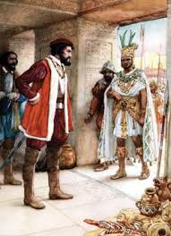
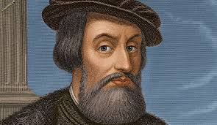
In 1519 Hernando Cortes set sail for Mexico in search of gold. He was welcomed by the Aztec Emperor Montezuma. Cortes wished only to take the wealth of the Aztecs and took Montezuma prisoner. This caused a lot of fighting. The Spanish overtook the Aztecs and began building a new city called Mexico City, the capital of the colony New Spain.

Slide 5
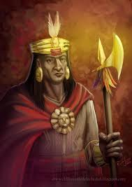
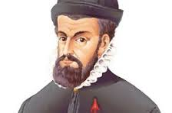
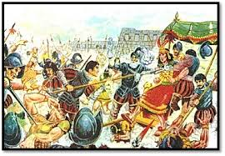
In 1531 Francisco Pizzaro a conquistador (Spanish conqueror) captured Inca emperor, Atahualpa and executed him. Pizarro gained control of much of the Incan Empire.

