Slide 1
The Articles of Confederation
America’s First Government

Slide 2
After rejecting British rule the first task of each state was to create their own constitutions
1. In 1775 many Americans wondered if they could create a central government that would unite the states effectively. 2. Each state wrote a constitution or document that sets out the laws and principles of a government. 3. The states divided power between an executive and legislative. Every state had a governor to execute, or carry out, the laws. Only white males over 21 could vote.

Slide 3
4. The Articles of Confederation, the first American constitution, created a weak central government partially because some Americans were still loyal to their individual state.
Provisions:
each state would send delegates to Congress
each state had one vote in Congress
Congress had the power to declare war, appoint military officers, and coin money
Problems:
States had final authority
Congress could not regulate trade between states
There was no President
Congress did not have the power to tax
Foreign countries did not respect the nation

Slide 4
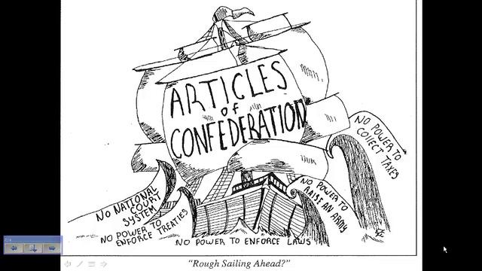

Slide 5
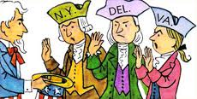
Issues related to the Articles
Nine of the 13 states had to agree on any major law.
All 13 states had to agree to amend ( change) the Articles.
The new government’s major problems involved money.
Large war debts with no way to pay it off
No power to impose or collect taxes
Could not afford an army or navy nor require men to join the military
Could not repay money it borrowed from foreign governments and from individual Americans during the war

Slide 6
5. Maryland refused to ratify the Articles of Confederation unless other states ceded, or gave up their western claims. In 1781 their demands were met and the Articles were ratified.
6. Disputes still arose among states and the U.S. owned millions of dollars to foreign nations. The paper currency had become worthless so states printed their own currency which caused more problems.

Slide 7
Economic Problems
Private citizens and businesses in every state had money problems after the war.
New England’s trade with Britain and the British West Indies was lost. Traders had to pay high customs duties (taxes).
The southern economy was hurt without Great Britain’s support of key colonial cash crops such as indigo and tobacco.

Slide 8
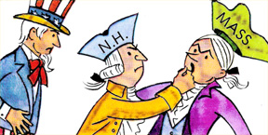
Economic problems
While Congress issued money so did every state
Paper money that was not backed by gold or silver—led to inflation (decrease in the value of money)
States could levy taxes but the national gov could not
Some states required taxes be paid in gold or silver.
People who could not pay were jailed.
Farms and businesses were seized as a way of collecting taxes

Slide 9
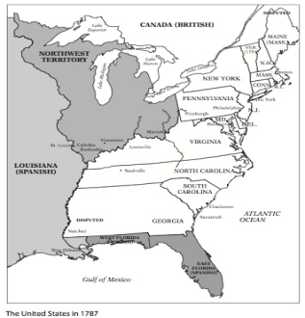
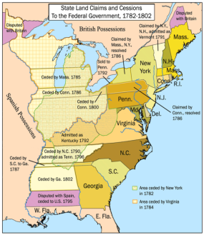
What to do with unsettled land?
NORTHWEST TERRITORY (Lands lying north of the Ohio River and east of the Mississippi River)
Land Ordinance 1785- called for land to be divided into townships and set aside land for public schools
Northwest Ordinance, 1787- set up a government for the Northwest Territory, outlawed slavery in the territory and allowed a territory to become a state when it had 60,000 free citizens.
**Important because it set up a way for new states to enter the Union. (Ohio, Indiana, Illinois, Michigan, and Wisconsin)

Slide 10
Western lands
7. After the Revolution the nation suffered an economic depression. After the Revolution prices fell on farm goods and farmers could not repay their loans. Courts seized the farms of those who could not pay taxes or loans. Farmers were angry because they felt they were being treated unfairly.
8. Daniel Shay a Massachusetts farmer organized an uprising. More than 1,000 farmers attached courthouses and prevented the state from seizing farms. The uprising was known as Shay’s Rebellion and was put down by the militia.
9. This was a sign that the Articles of Confederation were not working.

