Slide 1
The Constitutional Convention
Our New form of Government

Slide 2
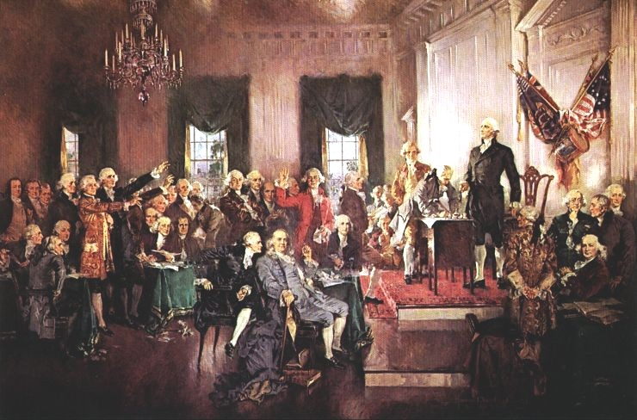
1. The Constitutional Convention (May 25, 1787) was called to revise the Articles of Confederation
In May 1787 delegates met in Philadelphia to write a new constitution.
Every state except Rhode Island sent representatives.
George Washington was elected President of the Constitutional Convention.
Alexander Hamilton said the nation needed a strong central government.

Slide 3
James Madison was the best prepared delegate. He is often called the “Father of the Constitution.”
The delegates decided to keep their talks secret because they wanted to explore every issue and solution without outside pressure.
It became clear that the nation needed a new constitution.

Slide 4
2. Virginia Plan- favors large states
Presented by James Madison and Edmund Randolph
Strong national government with 3 branches. The legislative (passes the laws), the executive (carries out laws), and judicial (decides if laws are carried out fairly).
Two house legislature with a lower house and an upper house. Seats would be given based on population.
Small states objected because they thought that they would be out voted by the larger states.

Slide 5
2. The New Jersey Plan- favors small states
Presented by William Patterson
3 branch government
One house legislature where each state would have one vote.

Slide 6
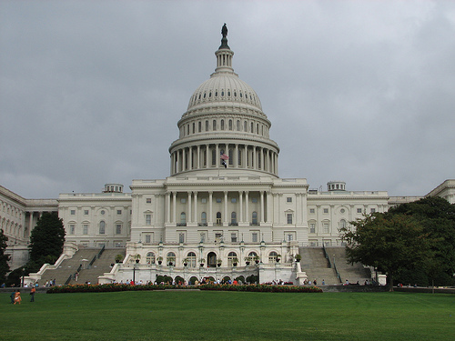
The Great Compromise
4. Roger Sherman sponsored the Great Compromise
The legislature would have two houses.
The plan called for the House of Representatives where states would be represented based on population.
The Senate where states would be represented equally.
Each state had 2 Senators. These two houses make up the Congress of the United States.

Slide 7
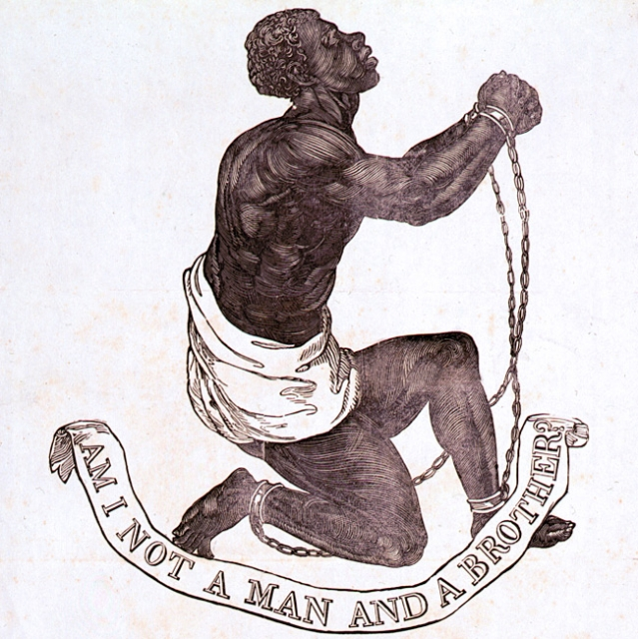
The 3/5 Compromise
5. The three-fifths Compromise: three fifths of the a state’s slave population would be counted for both taxation and representation.

Slide 8
Ban on slavery?
6. Northerners wanted Congress to ban the slave trade in the new nation.
However, southerners objected because their economy would be ruined.
They agreed to let the trade continue for 20 years and then Congress would be allowed to regulate it.
7. On September 17, 1789 the Constitution was ready to be signed.
Once 9 states endorsed it, the Constitution would go into effect.

