Slide 1
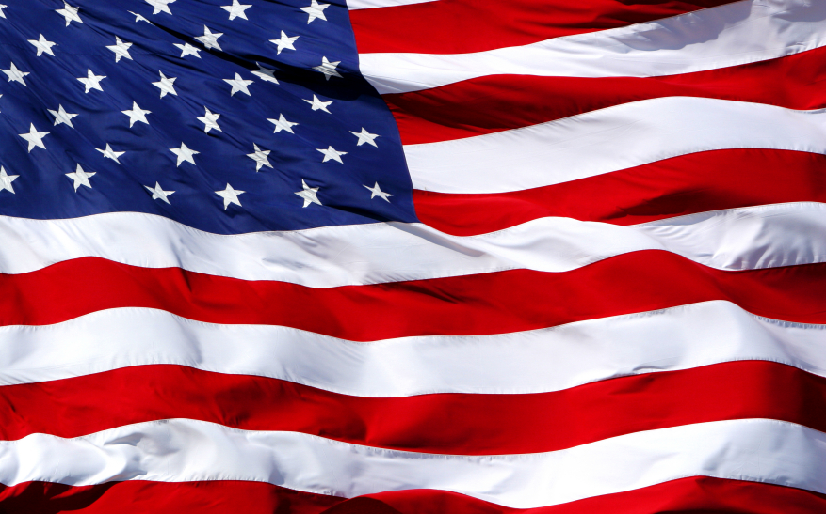
Unity & Division AIM: How did Unity & Division affect the early U.S.?

Slide 2
Terms to Know
Sectionalism – loyalty to one’s state or section rather than to the nation as a whole.
American System – program for economic growth promoted by Henry Clay; called for high tariffs on imports.
Interstate Commerce – trade between different states.

Slide 3
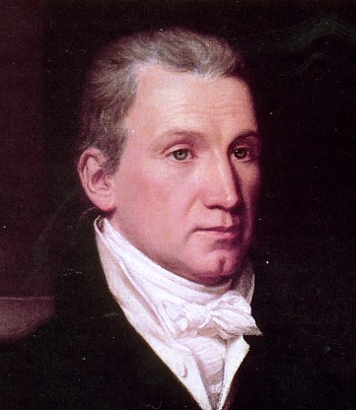
Era of Good Feelings
1816: Republican James Monroe easily defeats Federalist Rufus King for Presidency.
Election shows the decline of the Federalist party.
Last Revolutionary War officer to become President.
Americans adored him.
Monroe helped create a national unity among the American people.

Slide 4
Three Sectional Leaders
By the time Monroe ran for a 2nd term in 1820, no candidate opposed him.
The Federalist party had disappeared.
Conflict between political parties declined, but disputes between different sections of the nation increased.
Three men in Congress took center stage and each represented a different section of the country.

Slide 5
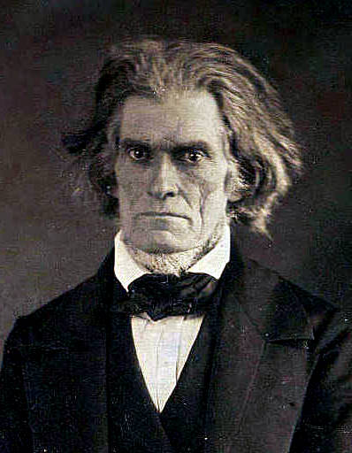
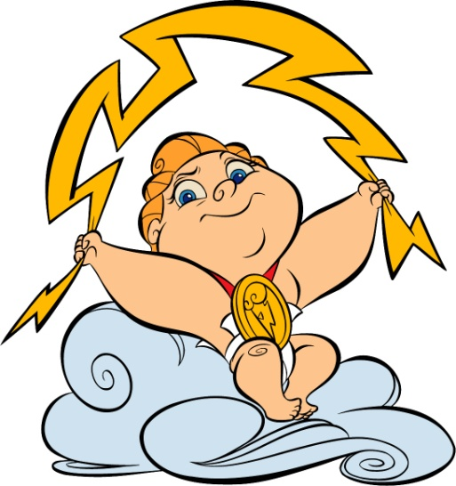
John C. Calhoun
Spoke for the South.
Intense speaker.
Defender of slavery.
Supported War of 1812.
Opposed policies that would strengthen the power of the federal government.
“Young Hercules”

Slide 6
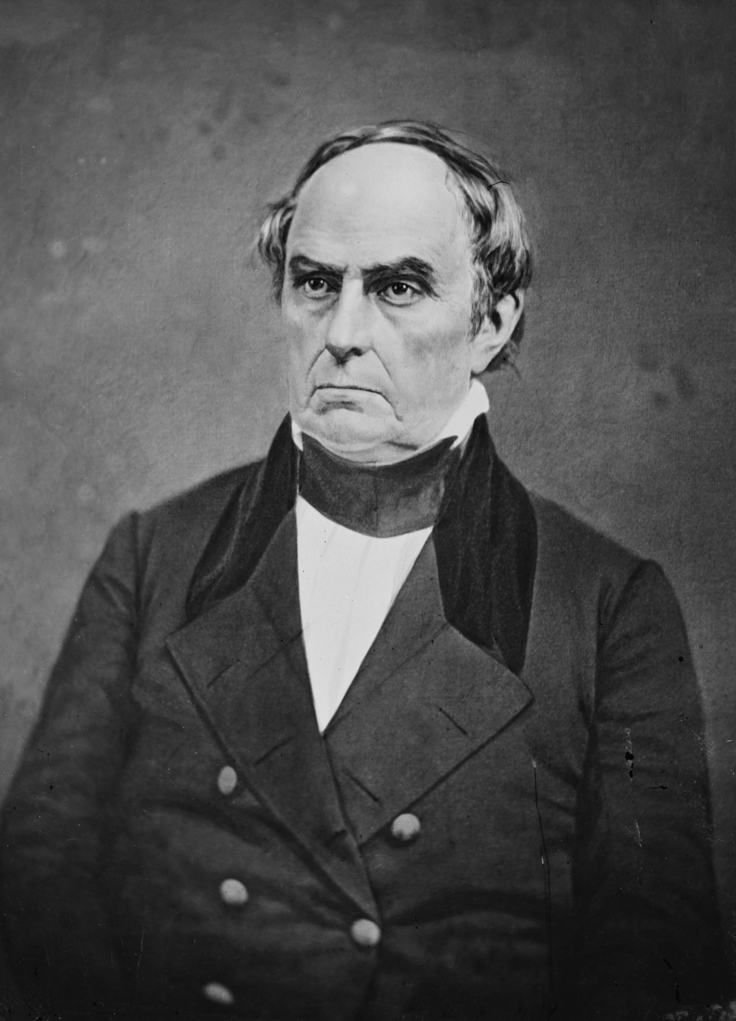
Daniel Webster “Webster of the North”
Most skillful public speaker of his time.
Opposed War of 1812.
Refused to vote for taxes to pay for war.
Wanted the federal government to take a larger role in building nation’s economy.
Felt slavery was evil.

Slide 7
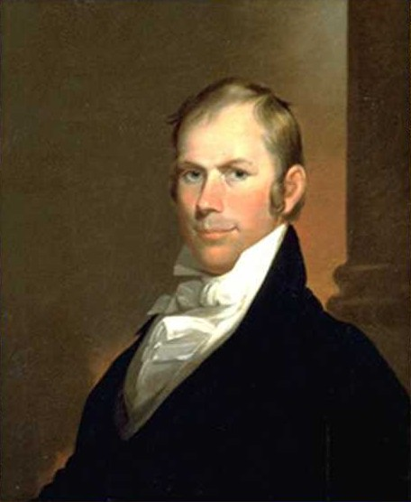
Henry Clay “Clay of the West”
Spoke for the West.
Pushed for war against Britain in 1812.
Leader of the War Hawks.
Favored a more active role for the central government.

Slide 8
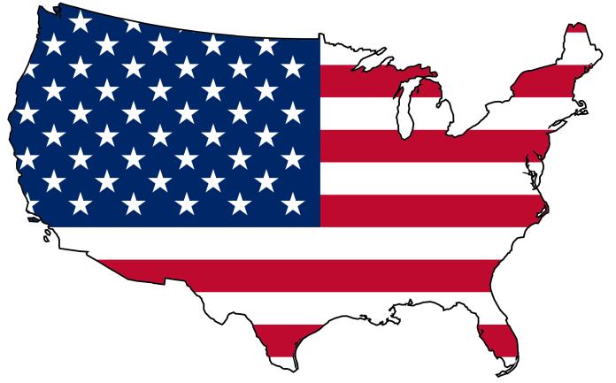
Helping American Business Grow
After the War of 1812, leaders had to deal with serious economic problems.
U.S. economy faced severe problems due to the lack of a national bank.
Without a bank to lend money and regulate the nation’s money supply, the economy suffered.
By 1816, the 2nd Bank of the U.S. was created. It helped American businesses grow.

Slide 9
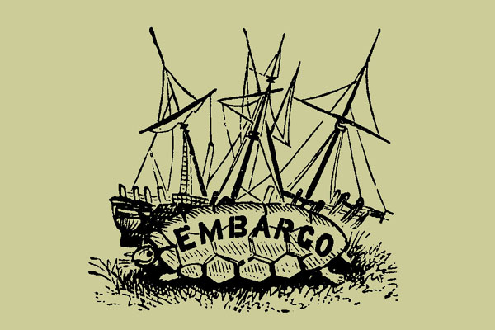
Protection from Foreign Competition
Another economic problem facing the nation was foreign competition.
Who was our biggest competition?
In early 1800’s, the Embargo Act & War of 1812 kept British goods out of America.
What effect did this have on
American industry?
As a result, American industry
grew quickly until 1815.

Slide 10
A Flood of British Goods
With the end of the War of 1812, British goods again poured into the U.S.
Why do you think this is?
Since the Industrial Revolution started in Britain, they could make & sell goods more cheaply.
British sold cloth in the U.S. for
less than it cost to make.
Why do you think they did this?

Slide 11
Congress Passed a Protective Tariff
British plan caused many New England businesses to fail.
Congress passed protective tariff in 1816.
Tariff made imported goods far more expensive than American made goods.
Southerners complained:
No factories built.
Bought many British goods.
Felt it made Northern manufacturers
rich at the expense of the South.

Slide 12
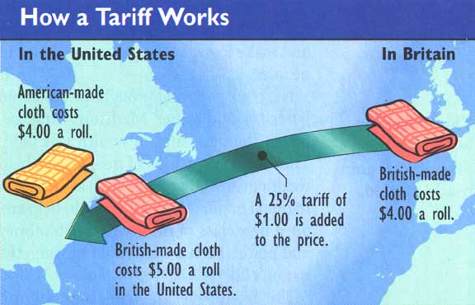

Slide 13
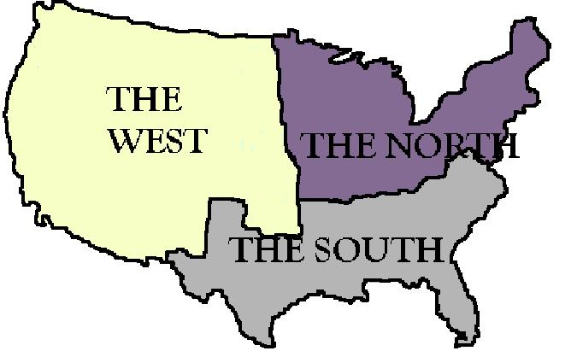
Clay’s American System
The bitter dispute over tariffs reflected the growth of sectionalism.
Americans identified themselves as Southerners, Northerners, or Westerners.
Henry Clay wanted to promote economic growth for all sections.
Introduced a program called the American System.

Slide 14
Clay’s American System
American System
Called for high tariffs on imports
Thought to help Northern factories
With wealth, Northerners would buy farm products from the West & South
High tariffs would reduce American dependence on foreign goods
Urged Congress to use money from tariffs to build roads, bridges, & canals

Slide 15
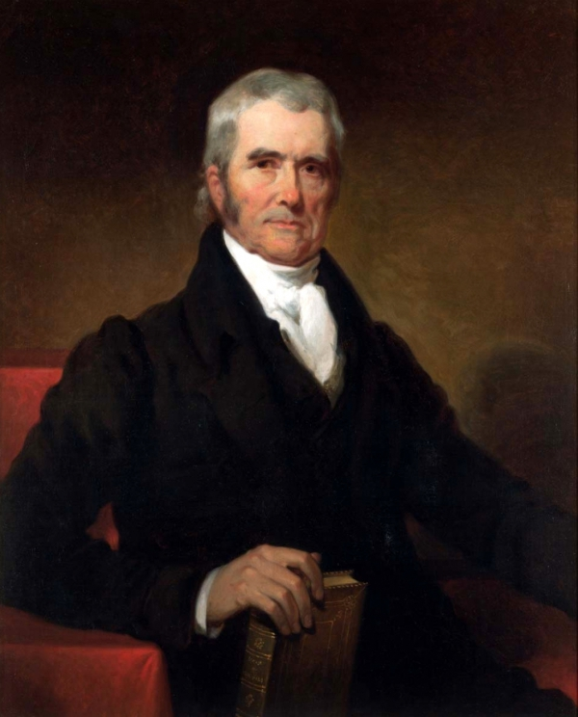
The Supreme Court Expands Federal Power
Chief Justice John Marshall extended the power of the federal government to promote economic growth.
McCulloch v. Maryland (1819)
Court ruled states had no right to interfere with federal institutions within their borders.

Slide 16
The Supreme Court Expands Federal Power
Gibbons v. Ogden (1824)
Upheld the power of the federal government to regulate commerce (trade).
A state could only regulate trade within its own borders.
Only the federal government had the power to regulate interstate commerce.

Slide 17
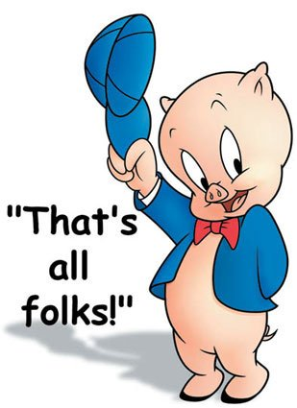
REVIEW
James Monroe
Three sectional leaders
National Bank
Foreign Competition
Protective Tariff
Clay’s American System
Chief Justice John Marshall

