Slide 1
Using Historical Evidence
Primary and Secondary Sources

Slide 2
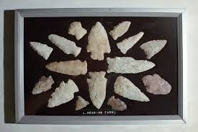
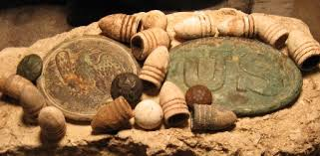
History is the story of the past. Historians are the people who study and write about history. Historians collect artifacts in order to help them interpret events. They obtain their evidence in many ways.

Slide 3
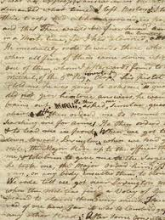
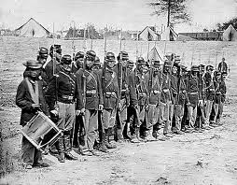
First historians look for primary sources. A primary source is first hand information about people or events. They include documents left by eyewitnesses such as a diary/journal, letters/emails, photograph. Interviews are also primary sources (when recorded)

Slide 4
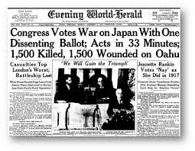
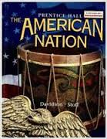
Historians also use secondary sources. A secondary source is an account provided after the fact by people who did not witness or participate in the event. Some examples of secondary sources include newspaper, textbook, encyclopedia, and people.

Slide 5
http://www.bing.com/videos/search?q=primary+and+secondary+sources+video&view=detail&mid=75D08D4825829273C68675D08D4825829273C686&FORM=VIRE&adlt=strict
http://www.bing.com/videos/search?q=primary+secondary+sources+video&adlt=strict&view=detail&mid=328F8B86E309D4A7BD95328F8B86E309D4A7BD95&FORM=VRDGAR

